Slide 1
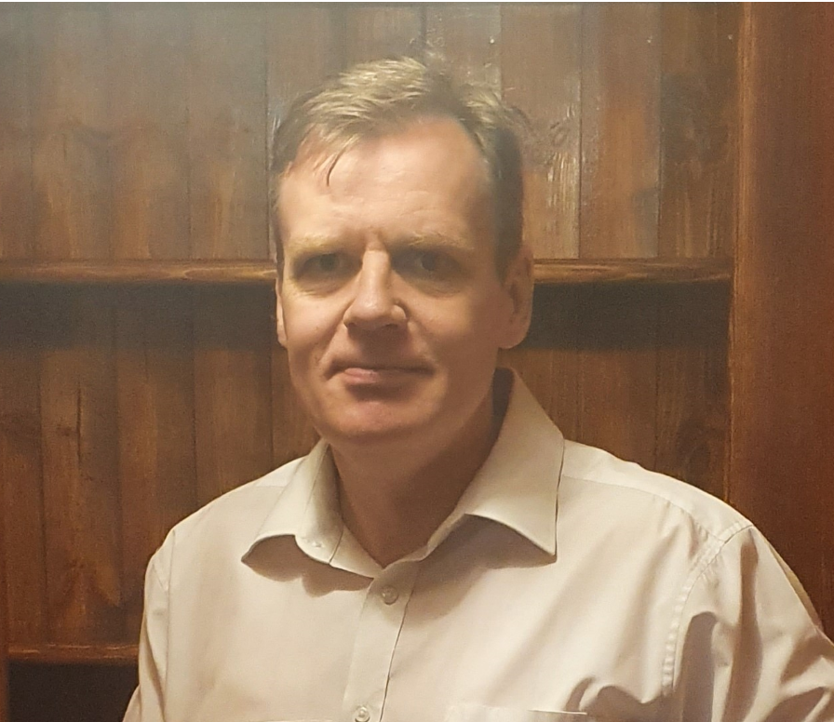
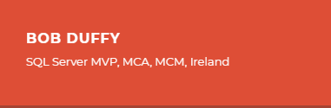
Modeling Workflow and Events in Progress
(Helpdesk, CRM, HubSpot, Dynamics, Workitem, S-chain)
16th May 2022. 6pm GMT

Slide 2

Bob Duffy
30 years in database sector, 250+ projects
SQL Server MCA, MCM, MVP
SSAS Maestro
Power BI FTRSA
Senior Data Platform Consultant with Microsoft 2005-2008
Data Architect at Prodata SQL Centre of Excellence
(aka data monkey)
http://blogs.prodata.ie/author/bob.aspx
bob@prodata.ie

Slide 3
Agenda
Demo Time
  Column Store Maintenance
    Fragmentation
    Open Row Groups
    Deleted Row Groups
  Stats Maintenance
    Missing Stats
    Stale Stats
    Overlapping stats
    Incrementing Stats
  Productionisng Maintenance

Slide 4
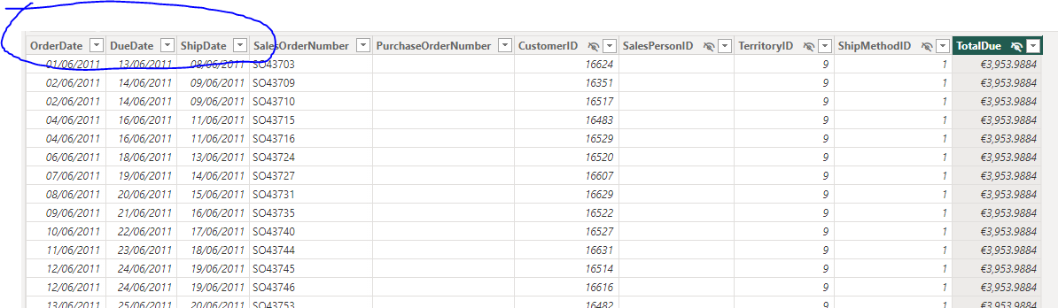
What is Events in Progress
Entity goes through many states and has date for them
https://dataedo.com/samples/html/AdventureWorks/doc/AdventureWorks_2/tables/Sales_SalesOrderHeader_185.html

Slide 5
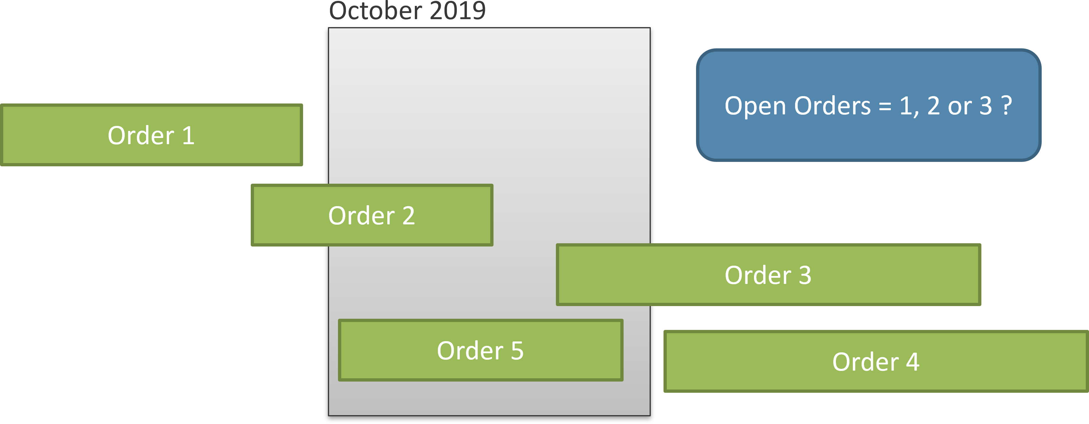
Calculating “Open or Unshipped” orders
https://www.daxpatterns.com/events-in-progress/

Slide 6
Demo Time
https://github.com/ProdataSQL/Demos/PBI/WorkFlow

Slide 7
Summary of Events in Progress
Great for when each “event” has a fixed date
Works best with one row per entity
Not so good for most CRMs and Workflow
  Events can be dynamic
  Data rows can be versioned

Slide 8
Sample CRM Data (Hubspot)
Great for when each “event” has a fixed date
Not so good for most CRMs and Workflow
  Events can be dynamic
  Data rows can be versioned and change over time

Slide 9
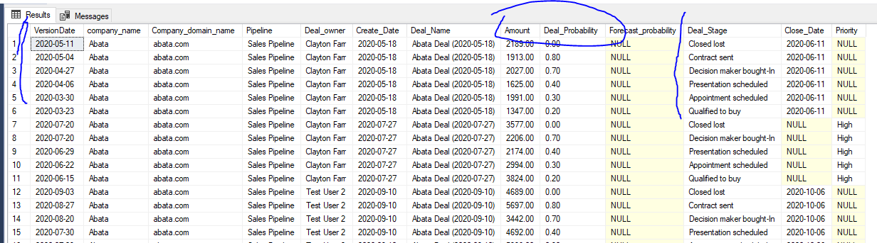
More Realistic CRM Data
Demo

Slide 10
How can we handle History and Changes
Snapshot is the most basic way
Last Ever Non Empty (LENE)
Last Version using Rank
https://blog.crossjoin.co.uk/2013/01/15/a-different-approach-to-last-ever-non-empty-in-dax/

Slide 11
Using Rank as a set
Deal 1 Event 1
Deal 1 Event 2
Deal 1 Event 3
Deal 1 Event 4
Min and Max Date Range

Slide 12
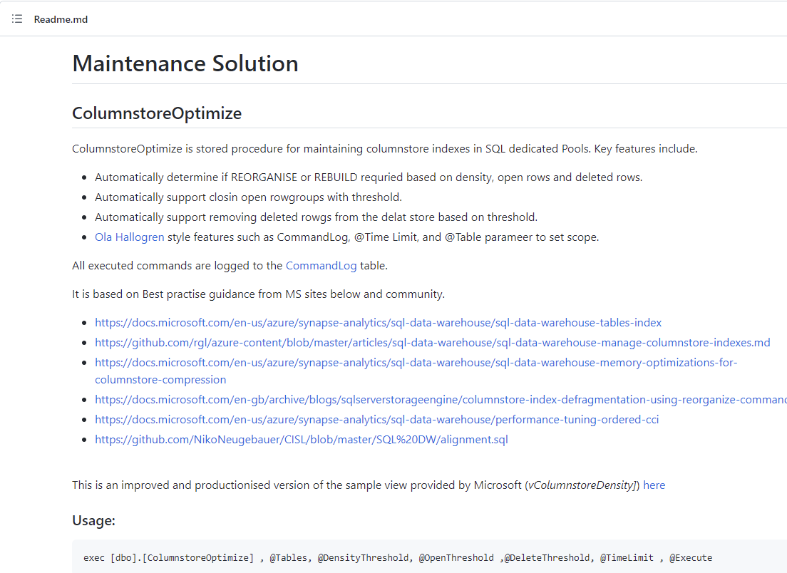
Github Source Code
https://github.com/ProdataSQL/SynapseTools/tree/main/SqlPools/Maintenance

Slide 13
Useful Links. 1/2
Last Ever Non Empty
https://blog.crossjoin.co.uk/2013/01/15/a-different-approach-to-last-ever-non-empty-in-dax/
Events in Progress
https://www.daxpatterns.com/events-in-progress/

